Slide 1


SMART INDIA HACKATHON 2020
PROBLEM STATEMENT- Detection of Child Predators/ Cyber Harassers on Social Media
PROBLEM ID- RK307
MINISTRY/ ORGANISATION- Bureau of Police Research & Development
DOMAIN- Security and Surveillance

Slide 2

Madras Institute Of Technology Campus
Anna University
PREVENTION OF EMOTIONAL ENTRAPMENT OF GIRLS ON SOCIAL MEDIA PLATFORMS
Team SPHYNX
Members-
Kirupalini S
Gowri S Swetha S
Amruthavarshini R
Gayathri Rengarajan
Aditi Baskar
Mentors-
Dr. D Sangeetha (Academia)
Vignesh Sankaran (Industry- Pentafox)

Slide 3
GENDER MODULE
Similar to the age module wherein the gender will be determined after monitoring the conversations for 15 days.
Gender detection on blogs is generally done by analysing the topic and associating that topic with a particular gender.

Slide 4
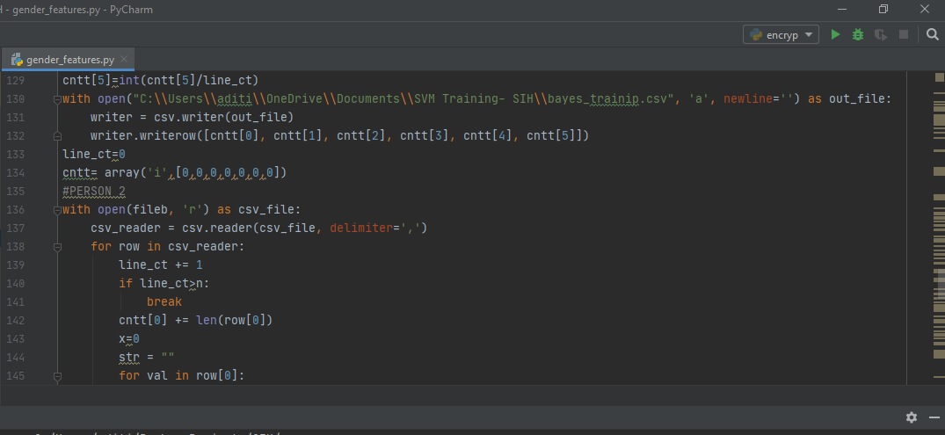
Reference paper- Chat Mining for Gender Prediction, Tayfun Kucukyilmaz, Bilkent University.
Technology stack- Naïve Bayes algorithm

Slide 5
CHAT BOT IDENTIFICATION
Main problem- dataset
Approach-
Build a chat bot to mimic a child.
Deploy the bot to about 100 people
Mine the conversations for patterns

Slide 6
Some of the features we have come up with to detect bots-
Obsessed with a particular topic.
Responds quickly and does not speak naturally as human does.
Multilingual responses possible.
Responds repetitively to onomatopoeic messages and emotional messages.

Slide 7
THANK YOU

